Slide 2
Biologically inspired algorithms Exercise 2
Ing. Lenka Skanderová, Ph. D.

Slide 3
Content
Solution and individual, neighbourhood
Local Search algorithms
Hill Climbing
Tabu Search

Slide 4
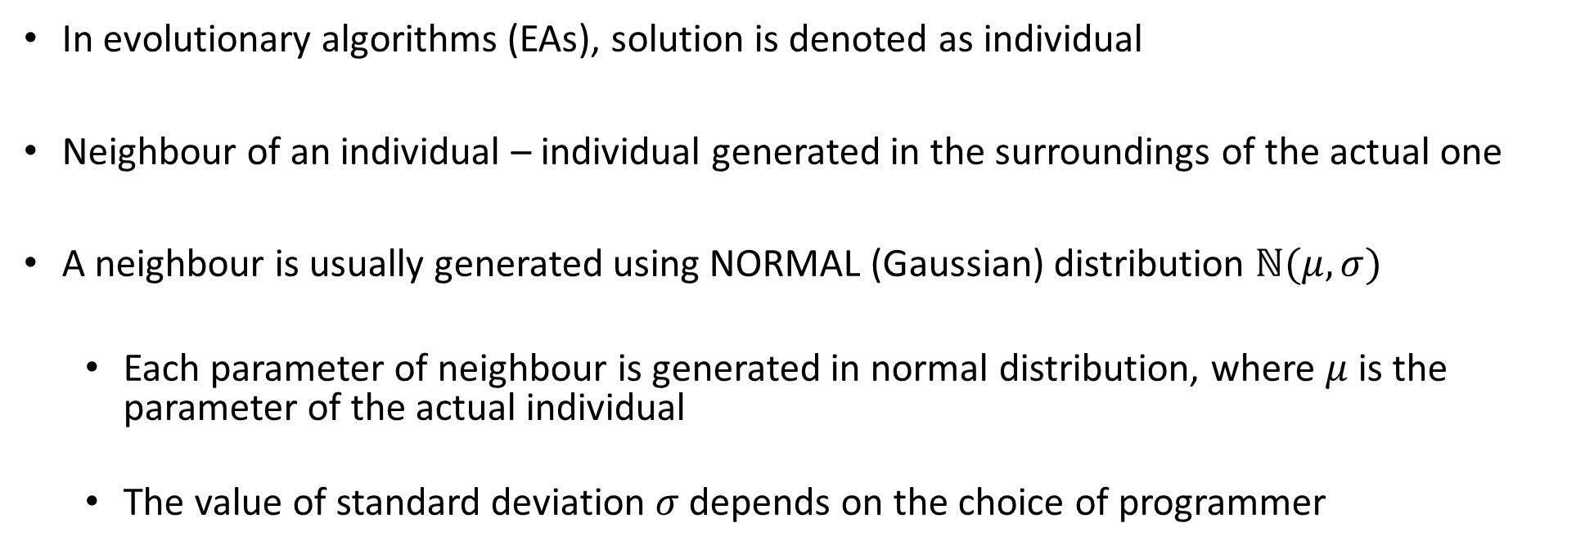
Solution & Individual
In evolutionary algorithms (EAs), solution is denoted as individual
Neighbour of an individual – individual generated in the surroundings of the actual one
A neighbour is usually generated using NORMAL (Gaussian) distribution $ℕ(μ,σ)$
Each parameter of neighbour is generated in normal distribution, where $μ$ is the parameter of the actual individual
The value of standard deviation $σ$ depends on the choice of programmer

Slide 5
Solution & Individual
Generation of a parameter of a neighbour in Python :
p[i] = np.random.normal(self.params[i], sigma)
p[i] … i-th parameter of a neighbor p
np … numpy
self.params[i] … i-th parameter of an actual individual

Slide 6
Local Search Algorithms
Usually applied on the best individuals within the population of individuals to search for the global optimum
Usually work with one solution and its neighbor/s
Focused on exploitation

Slide 7
Hill Climbing
Derived from the process of hill climbing
Starts with initial solution randomly generated within the space of possible solutions
Works in generations
At each generation, one or more neighbours of an actual solution are generated.
If the best solution from neighbours is better than the actual solution, it will replace it. Otherwise, the actual solution remains

Slide 8


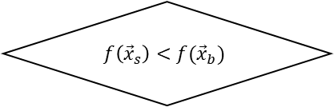
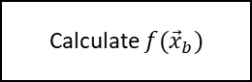
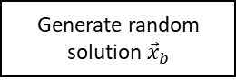


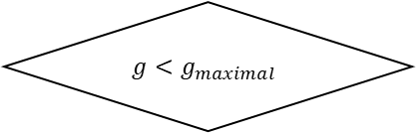
Hill Climbing – Single neighbor (minimization)
Start
Generate random solution ${\vec{x}}_{b}$
Less number of the objective function evaluations
Calculate $f({\vec{x}}_{b})$
Evaluate ${\vec{x}}_{s}$
$$g<g_{maximal}$$
No
$$f\left({\vec{x}}_{s}\right)<f({\vec{x}}_{b})$$
No
Return ${\vec{x}}_{b}$
End
Yes
Yes
$${\vec{x}}_{s}=ℕ({\vec{x}}_{b}, σ)$$
$${\vec{x}}_{b}={\vec{x}}_{s}$$

Slide 9
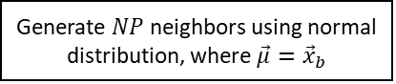
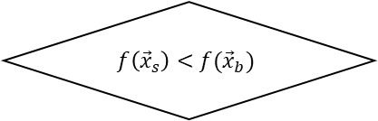
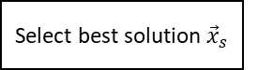
Hill Climbing – More neighbors (minimization)
Start
Generate random solution ${\vec{x}}_{b}$
Evaluate solutions
Calculate $f({\vec{x}}_{b})$
Select best solution ${\vec{x}}_{s}$
$$g<g_{maximal}$$
No
$$f\left({\vec{x}}_{s}\right)<f({\vec{x}}_{b})$$
No
Return ${\vec{x}}_{b}$
End
Yes
Yes
Generate $NP$ neighbors using normal distribution, where $\vec{μ}={\vec{x}}_{b}$
$${\vec{x}}_{b}={\vec{x}}_{s}$$

Slide 10
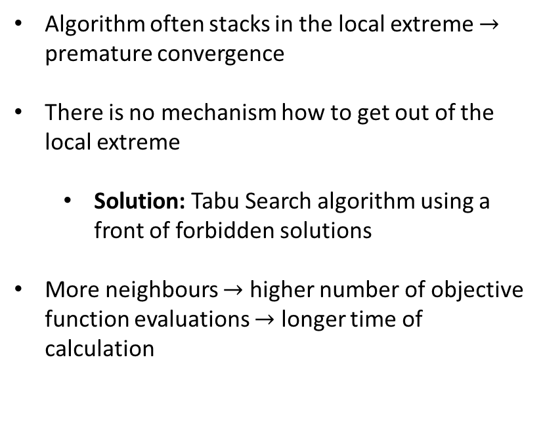
Hill Climbing – Behavior
Global extreme
Algorithm often stacks in the local extreme $→$ premature convergence
There is no mechanism how to get out of the local extreme
Solution: Tabu Search algorithm using a front of forbidden solutions
More neighbours $→$ higher number of objective function evaluations $→$ longer time of calculation
Local extreme
There is no better solution within the neighborhood
Actual solution neighborhood
Best neighbor
Actual solution

Slide 11
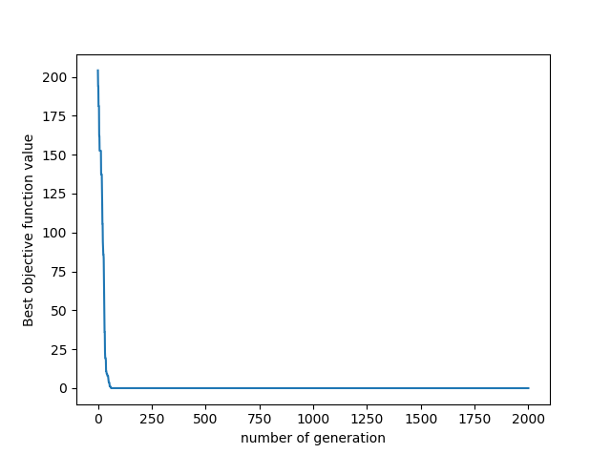
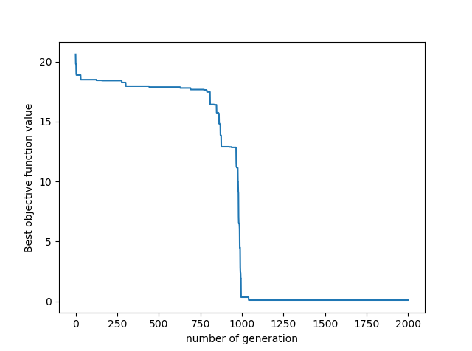
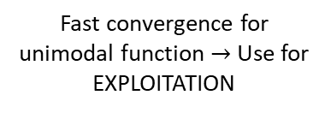
Hill Climbing – Behavior – 2 dimensions
Sphere function
Ackley function
Fast convergence for unimodal function $→$ Use for EXPLOITATION
Slow convergence for multimodal function. Risk of getting stuck at the local extreme

Slide 12
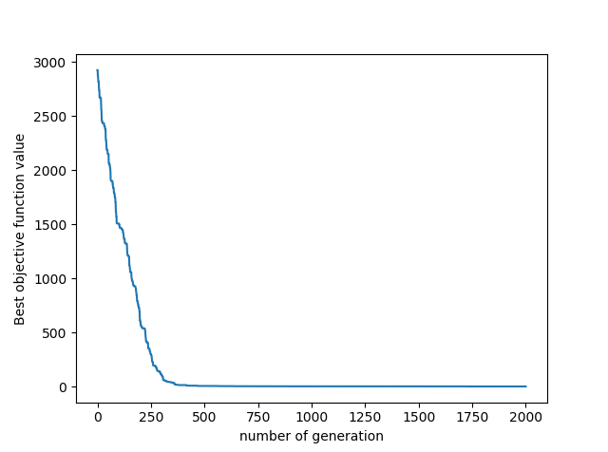
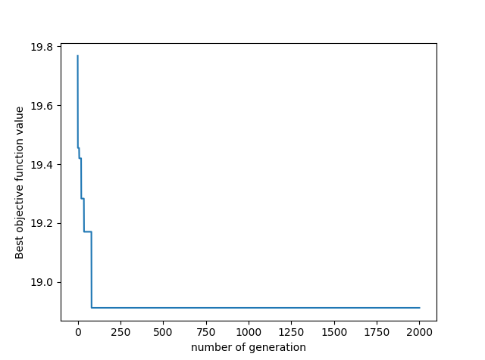
Hill Climbing – Behavior – 20 dimensions
Sphere function
Ackley function
Slower convergence, NOT premature convergence
Premature convergence

Slide 13
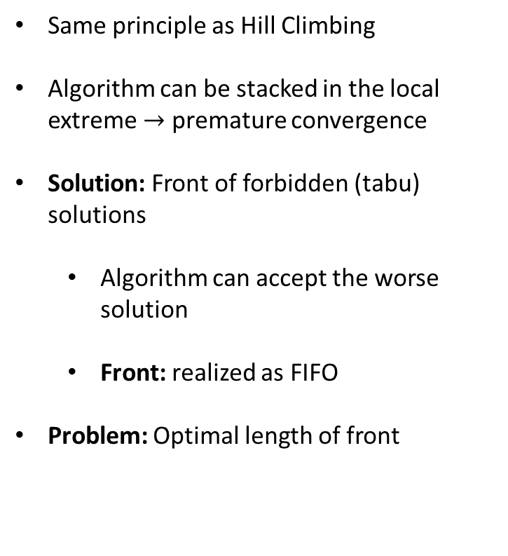
Tabu Search
Global extreme
Same principle as Hill Climbing
Algorithm can be stacked in the local extreme $→$ premature convergence
Solution: Front of forbidden (tabu) solutions
Algorithm can accept the worse solution
Front: realized as FIFO
Problem: Optimal length of front
Local extreme
There is no better solution within the neighborhood
Actual solution neighborhood
Best neighbor
Actual solution
Front of forbidden solution

Slide 14
Task
Implement Hill climbing algorithm
You can use one or more neighbours
Use normal distribution to generate neighbours
Visualize the process of search for the global optimum in 3-dimensional space. Use the test functions implemented for Task 1
Figure 1 represents the solution of Task
Figure 1: Hill Climbing used for Ackley function

Slide 15
Thank you for your attention
Ing. Lenka Skanderová, Ph.D.
EA 407
+420 597 325 967
lenka.skanderova@vsb.cz
homel.vsb.cz/~ska206

